Slide 1
5
Chapter
Organizational Structure and Culture

Slide 2
Organizing
Once the organization’s goals, plans, and strategies are in place, managers must develop a structure that will best facilitate the attainment of those goals.
  Recall that organizing is defined as the function of management that creates the organization’s structure.
  Organizational Design
    When managers develop or change the organization’s structure, they’re engaging in organizational design.

Slide 3
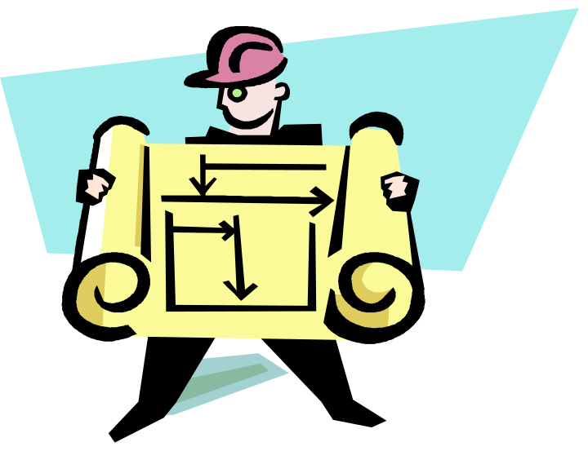
Organizational Structure
How job tasks are formally divided, grouped, and coordinated
  Key Elements:
    Work specialization
    Departmentalization
    Chain of command
    Span of control
    Centralization and decentralization
    Formalization
Notes:
(c) 2008 Prentice-Hall, All rights reserved.

Slide 4
  Work Specialization
  Dividing work activities into separate job tasks; also called division of labor
  Individual employees “specialize” in doing part of an activity rather than the entire activity in order to increase work output.
  At some point, the human diseconomies from division of labor surface as boredom, fatigue, stress, low productivity, poor quality, increased absenteeism, and high turnover exceed the economic advantages.

Slide 5
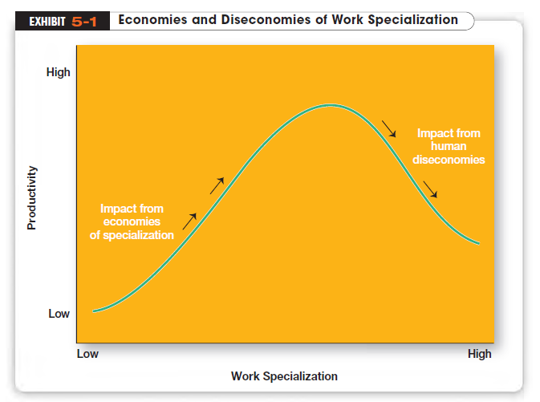

Slide 6
Departmentalization
How jobs are grouped together
  The method or methods used should reflect the grouping that would best contribute to the attainment of the goals of the organization and the individual units.
  There are five common forms of departmentalization although an organization may use its own unique classification.

Slide 7
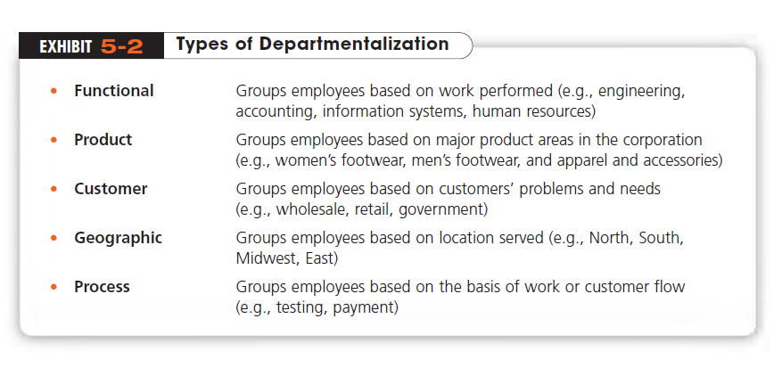
A recent trend is the use of Cross-functional Teams, which are teams made up of individuals from various departments and that cross traditional departmental lines.

Slide 8

What Are Authority and Responsibility?
Chain of Command
  The line of authority extending from upper organizational levels to lower levels, which clarifies who reports to whom
Authority
  The rights inherent in a managerial position to give orders and expect the orders to be obeyed
Responsibility
  When managers delegate authority, they also allocate an obligation to perform assigned duties

Slide 9
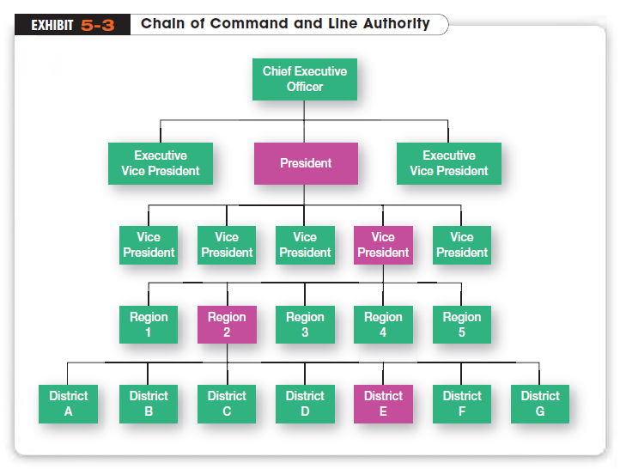
Different Types of Authority Relationships
Line Authority
  Authority that entitles a manager to direct the work of an employee. It is the employer–employee authority relationship that extends from the top of the organization to the lowest echelon, according to the chain of command
Copyright ©2011 Pearson Education

Slide 10
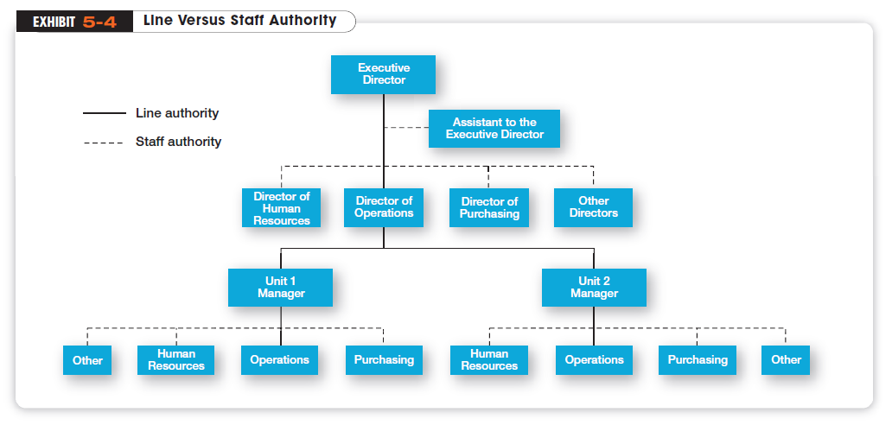
As organizations get larger and more complex, line managers find that they do not have the time, expertise, or resources to get their jobs done effectively. In response, they create Staff Authority
  Positions with some authority that have been created to support, assist, and advise those holding line authority to reduce some of the informational burdens (e.g. H.R.)

Slide 11
What Is Power?
Authority goes with the job, but Power
  refers to an individual’s capacity to influence decisions. Authority is part of the larger concept of power.
  That is, the formal rights that come with an individual’s position in the organization are just one means by which an individual can affect the decision process.

Slide 12
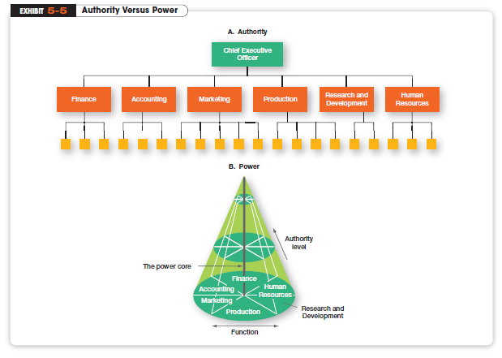
Exhibit 5-5 visually depicts the difference between authority and power.

Slide 13
The Power Core
The cone analogy explicitly acknowledges facts:
  The higher one moves in an organization (an increase in authority), the closer s/he gets to the power core.
  It is not necessary to have authority in order to wield power, because one can move horizontally inward toward the power core without moving up.
    Secretaries are “powerful” as gatekeepers with little authority.
  Low-ranking employees with contacts in high places might be close to the power core.
  So, too, are employees with scarce and important skills.
    A production engineer with twenty years of experience might be the only one in the firm who knows the inner workings of all the old production machinery.

Slide 14
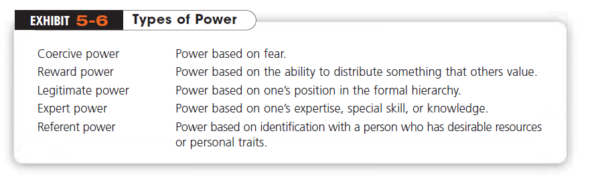
French and Raven identified five sources, or bases of power:

Slide 15
Span of Control
  How many employees can a manager efficiently and effectively supervise?
  This question of span of control received a great deal of attention from early management writers. Although early writers came to no consensus on a specific number, most favored small spans
  Typically no more than six workers—in order to maintain close control

Slide 16
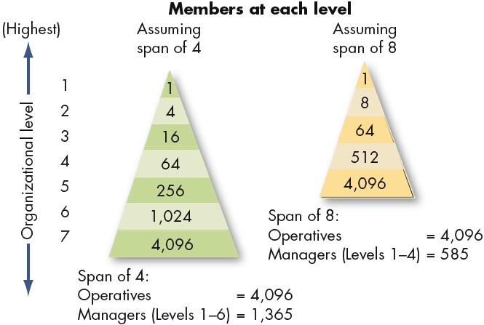
Contrasting Spans of Control
Notes:
(c) 2008 Prentice-Hall, All rights reserved.

Slide 17
What Is Formalization?
How standardized an organization’s jobs are and the extent to which employee behavior is guided by rules and procedures
Centralization
  The degree to which decision making takes place at upper levels of the organization
Decentralization
  The degree to which lower-level managers provide input or actually make decisions

Slide 18
What Contingency Variables Affect Structural Choice?
Mechanistic Organization
  A bureaucratic organization; a structure that’s high in specialization, formalization, centralization, and chain-of-command principle
Organic Organization
  A structure that’s low in specialization, formalization, and centralization
  Rather than having standardized jobs and regulations, the organic organization’s loose structure allows it to change rapidly as required
Notes:
The organic organization is a highly adaptive form that is as loose and flexible as the mechanistic organization is rigid and stable.

Slide 19
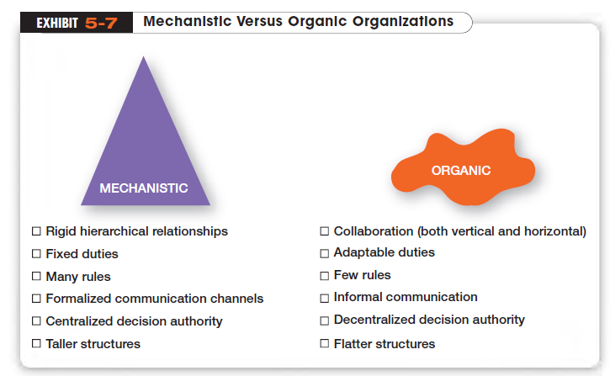

Slide 20
How Does Environment Affect Structure?
  Mechanistic organizations are most effective in stable environments.
  Organic organizations are best matched with dynamic and uncertain environments.
  The environment-structure relationship is why so many managers have restructured their organizations to be lean, fast, and flexible.
  Global competition, accelerated product innovation, knowledge management, and increased demands from customers for higher quality and faster deliveries are examples of dynamic environmental forces.
  Mechanistic organizations tend to be ill-equipped to respond to rapid environmental change.

Slide 21
How Does Technology Affect Structure?
Every organization uses some form of technology to convert its inputs into outputs. Joan Woodward categorized firms into distinct technologies that had increasing levels of complexity and sophistication.
  Unit Production
    The production of items in units or small batches
  Mass Production
    Large-batch manufacturing
  Process Production
    Most technically complex group, includes continuous flow of products process.

Slide 22
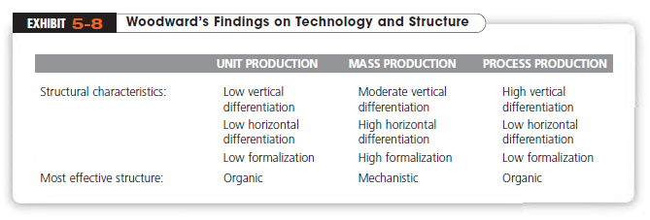

Slide 23
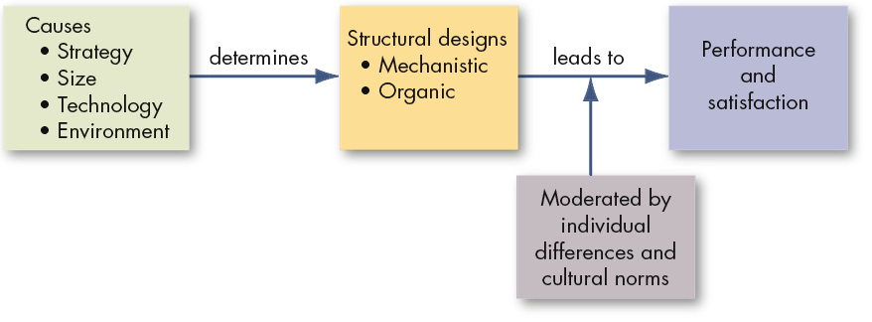
Managerial Implications
Structure impacts both the attitudes and behaviors of the people within it.
Notes:
(c) 2008 Prentice-Hall, All rights reserved.

Slide 24
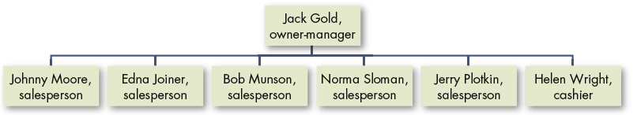
The first and most basic structure:
Simple Structure
Characterized by a low degree of departmentalization, wide spans of control, authority centralized in a single person, and little formalization
Weaknesses: effective only in small organizations; becomes inadequate as organization grows; few policies or rules to guide operations and high centralization result in information overload at the top; as size increases, decision making becomes slower and can eventually stop.
Notes:
(c) 2008 Prentice-Hall, All rights reserved.

Slide 25
Traditional Organizational Designs
Functional Structure
  An organizational design that groups similar or related occupational specialties together
  has cost saving advantage but units have little understanding on what others do
Divisional Structure
  An organizational structure made up of separate business units or divisions
  each division has limited autonomy, with a division manager who has authority over his or her unit and is responsible for performance.

Slide 26
Contemporary Organizational Structures
Team Structure
    A structure in which the entire organization is made up of work teams
    employee empowerment is crucial because there is no line of managerial authority from top to bottom
Matrix Structure
    A structure in which specialists from different functional departments are assigned to work on projects led by a project manager
    When employees finish work on an assigned project, they go back to their functional departments.
Notes:
Project Structure
Instead of a matrix structure, many organizations are using a project structure, in which employees continuously work on projects. Unlike the matrix structure, a project structure has no formal departments where employees return at the completion of a projects

Slide 27
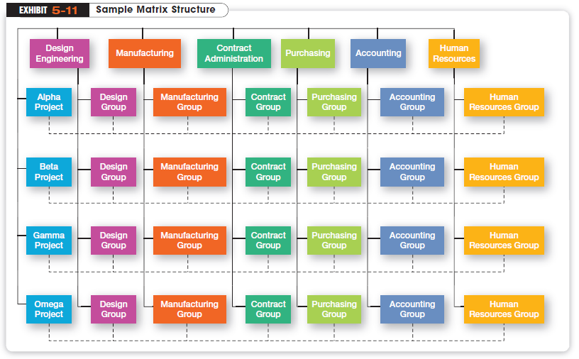

Slide 28
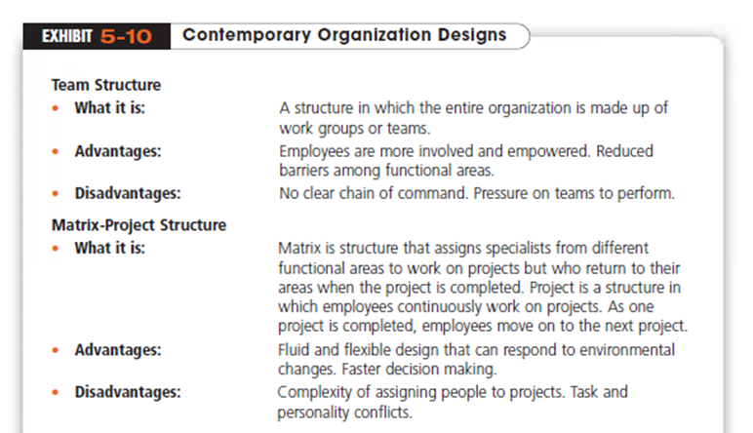

Slide 29
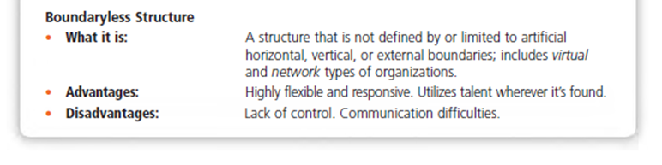
Contemporary Designs (cont.)
Virtual Organization
    An organization that consists of a small core of full-time employees and outside specialists temporarily hired as needed to work on projects

Slide 30
Contemporary Designs (cont.)
Network Organization
  Another structural option for managers wanting to minimize or eliminate organizational boundaries
  uses its own employees to do some work activities and networks of outside suppliers to provide other needed product components or work processes.
    sometimes called a modular organization by manufacturing firms.

Slide 31
Today’s Organizational Challenges
Learning Organization
  An organization that has developed the capacity to continuously learn, adapt, and change
  The concept of a learning organization doesn’t involve a specific organizational design per se, but instead describes an organizational mind-set or philosophy that has significant design implications

Slide 32
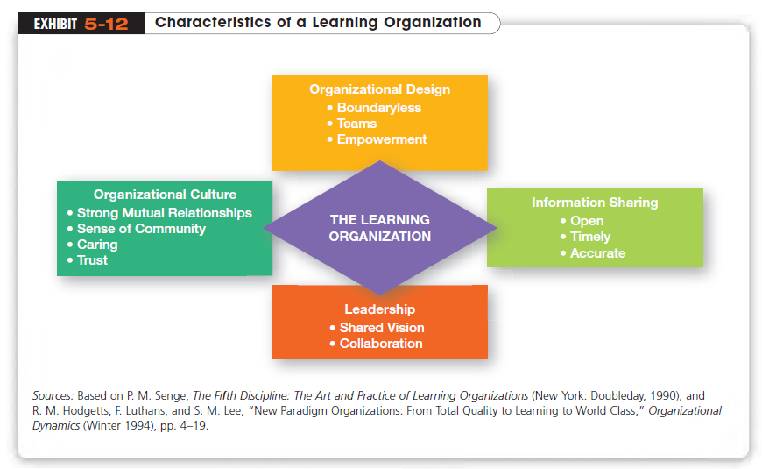

Slide 33
What is Organizational Culture?
  The shared principles, values, traditions, and ways of doing things that influence the way organizational members act
  In most organizations, these shared values and practices have evolved over time and determine, to a large extent, how “things are done”.

Slide 34
Organizational Stories
Corporate stories – convey history and legends; part of socialization
Personal stories – to suggest how they like to present themselves
Collegial stories – one person’s account of other members

Slide 35
Levels of Corporate Culture
Culture that can be seen at the surface level
Visible
1. Artifacts, such as dress, office layout, symbols, slogans, ceremonies
Invisible
2. Expressed values, such as “attention to detail”, “innovation and risk taking”, “aggressiveness”, “outcome orientation” “people orientation”, “team orientation”
Deeper values and shared understandings held by organization members

Slide 36
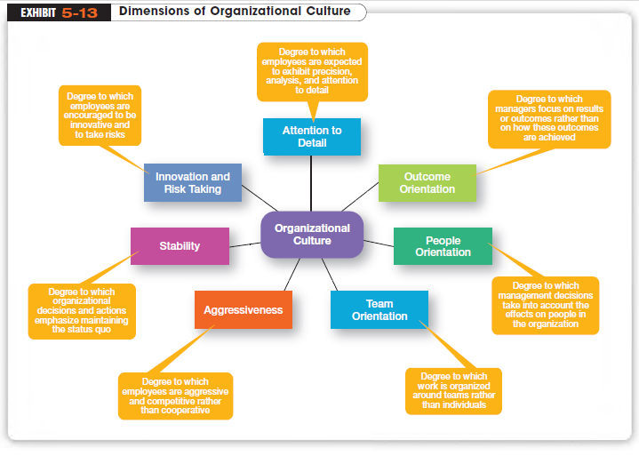

Slide 37
How Does Culture Influence Structure?
An organization’s culture may have an effect on its structure, depending on how strong, or weak, the culture is.
Organizational cultures in which the key values are deeply held and widely shared—have a greater influence on employees than do weaker cultures.
The more employees accept the organization’s key values and the greater their commitment to those values, the stronger the culture is.

Slide 38
Factors Behind Organizational Culture
Company history
Basic assumptions
Social and physical environment
Unique language
Values, attitudes, beliefs
Behavioral rules (observances, rituals)
Heroes
Ceremonies and rituals
Symbols and symbolic gestures
Myths, legends, metaphors, organizational stories, jokes..

